Slide 1
Presentation on National Academic Depository (NAD)
by
BV(DU) Examination Section, Pune

Slide 2
NAD (National Academic Depository)
NAD is an online store house of academic awards (degrees, diplomas, certificates, mark-sheets etc.) lodged by the academic institutions/ boards/eligibility assessment bodies in a digital format.
NAD is on 24/7 online modes for making available academic awards and shall help in validating their authenticity, their safe storage and easy retrieval.
Process-
Student Registration Process
Verification of Student by UNIVERSITY
Award Mapping Process by student

Slide 3
Start
NAD Flow Chart
Student has to Register on NAD portal
Student has to compulsory fill University’s online form
Award mapping by student
No
Student Verification by University
Student has to wait for Verification
No
Yes
View Award by student
Yes
Login Account will get active, Now Student will Login to NAD portal
End

Slide 4
Student Registration Process
Student first needs to register at NAD.
The email ID used for registration must belong to the student. The email ID must be valid and functional. All communications shall be sent only to the registered email ID.
Before the registration process, student must prepare the following;
Scan copy of Photograph and Scan copy of Signature in .jpeg format (up to 60kb).
Student should know his PRN which is mentioned on each marksheet and should also know the Admission year.

Slide 5
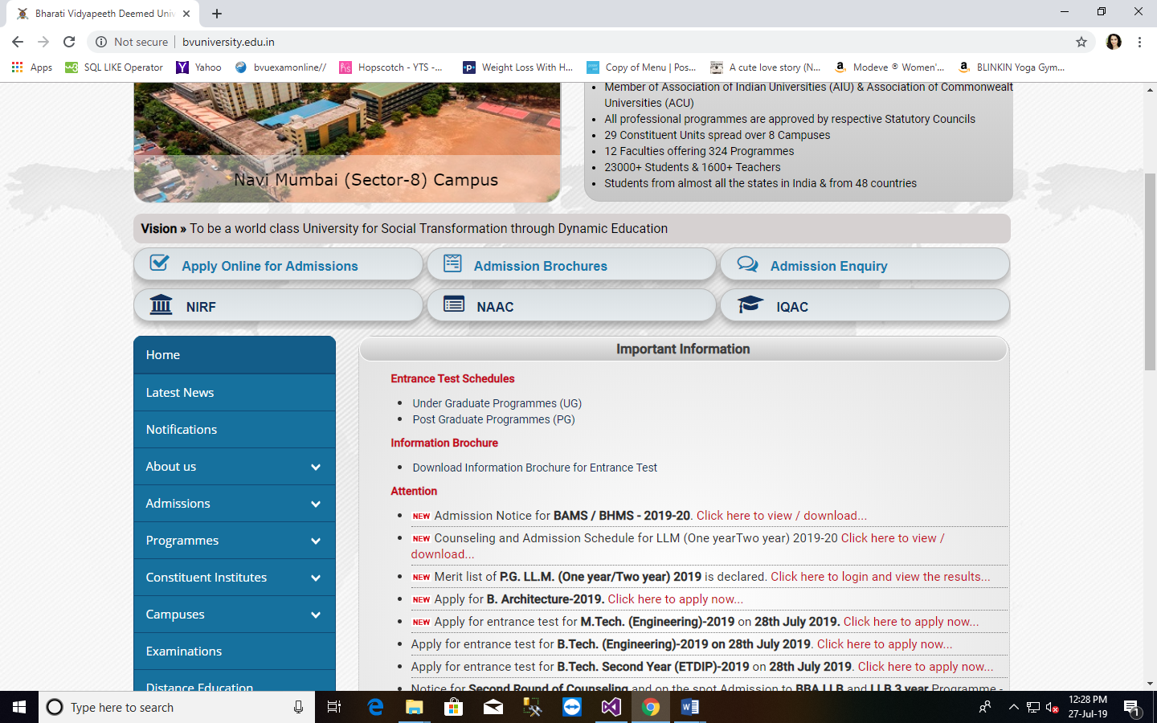
Steps for student Registration process :-
1.Visit http://bvuniversity.edu.in/ and go to Examinations tab

Slide 6
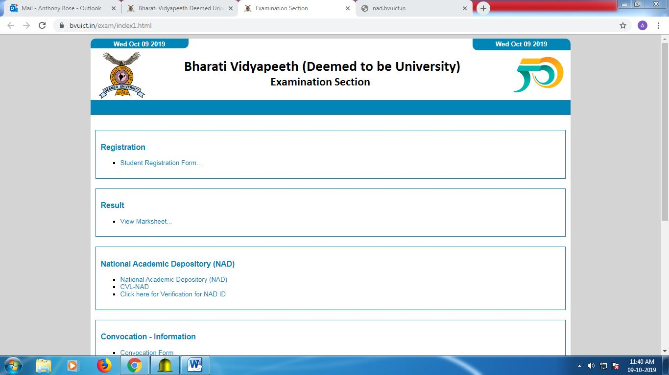
2. Select CVL-NAD which is present under National Academic Depository(NAD)

Slide 7
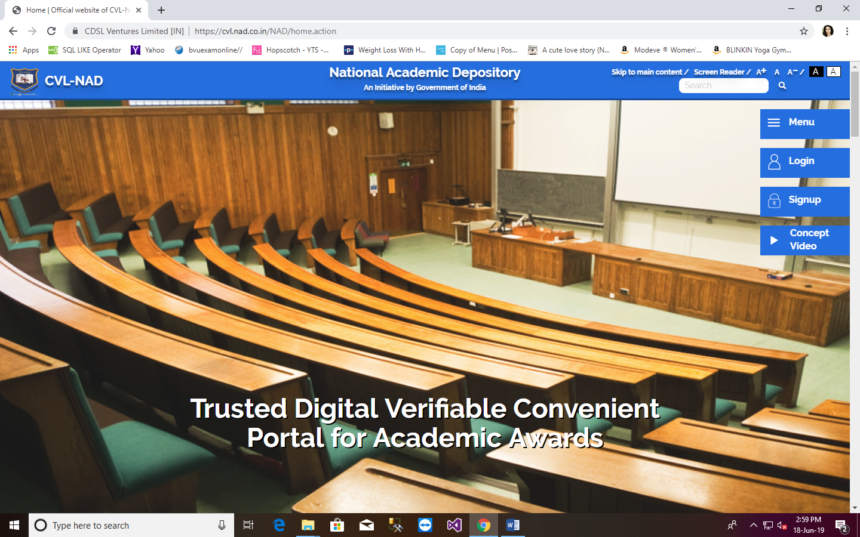
3. NAD website will get open. Click on Signup

Slide 8
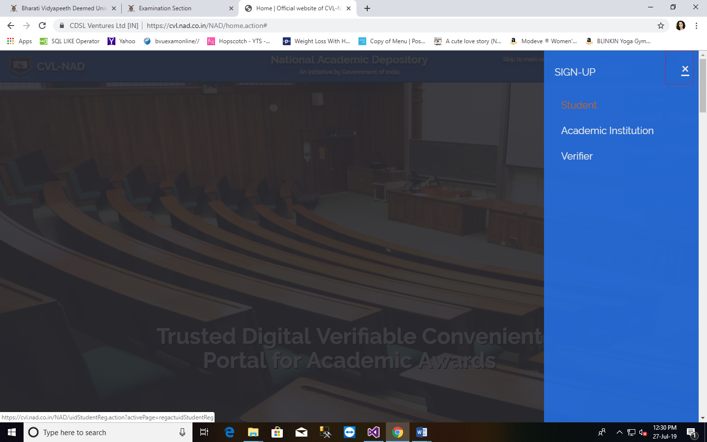
Select Student option

Slide 9
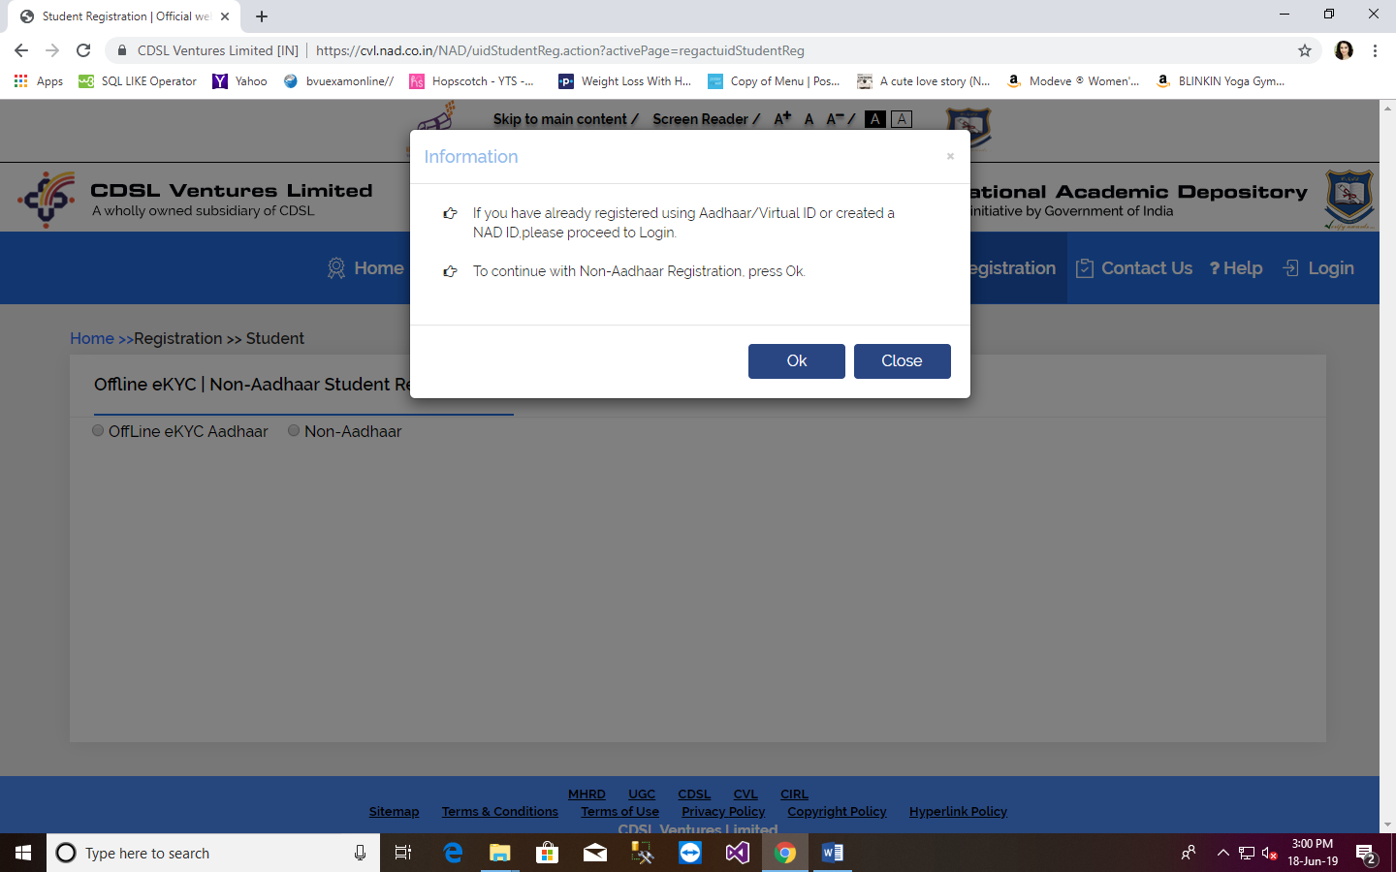
4. Pop Up window will appear, Click Ok and Select Non-Aadhaar option.

Slide 10
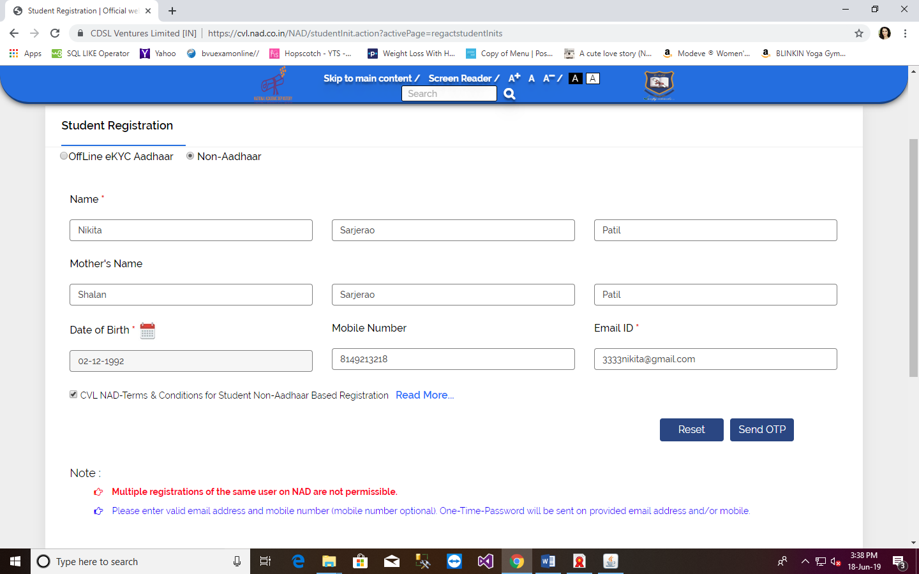
5. Fill all details and click on Send OTP button, OTP will get send on given Mobile number and on email Id.
XX-XX-XXXX XXX
XXXXXXXXXX XXX
XXXXXXXXXX@gmail.com

Slide 11
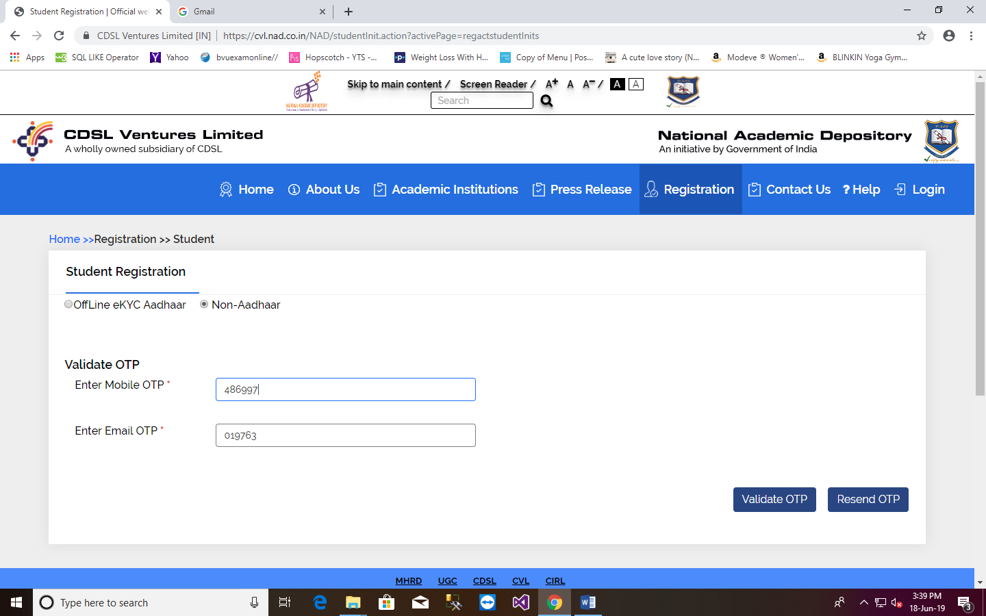
6. Validate OTP, which is received on mobile number and email Id

Slide 12
Fill all details, which are required
Primary Information
Create new Password
Address Details
Other Details(Upload scan copy of Photograph and Signature)
Primary Information
XX-XX-XXXX XXX
XXXXXXXXXX XXX
XXXXXXXXXX@gmail.com

Slide 13
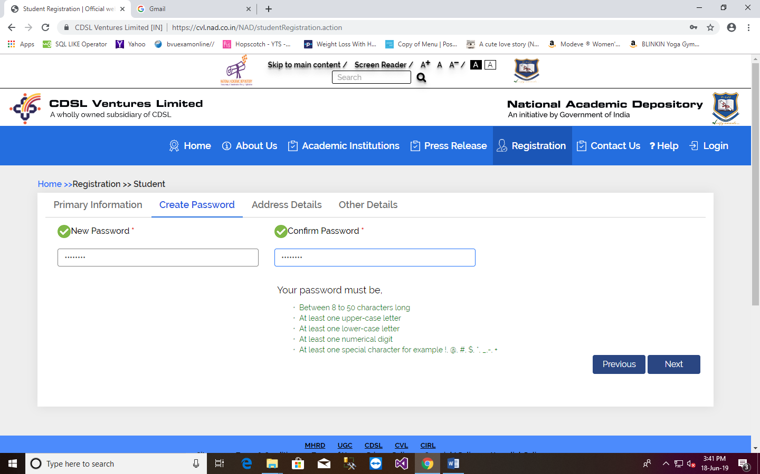
Create password using conditions which are mentioned below on form.

Slide 14
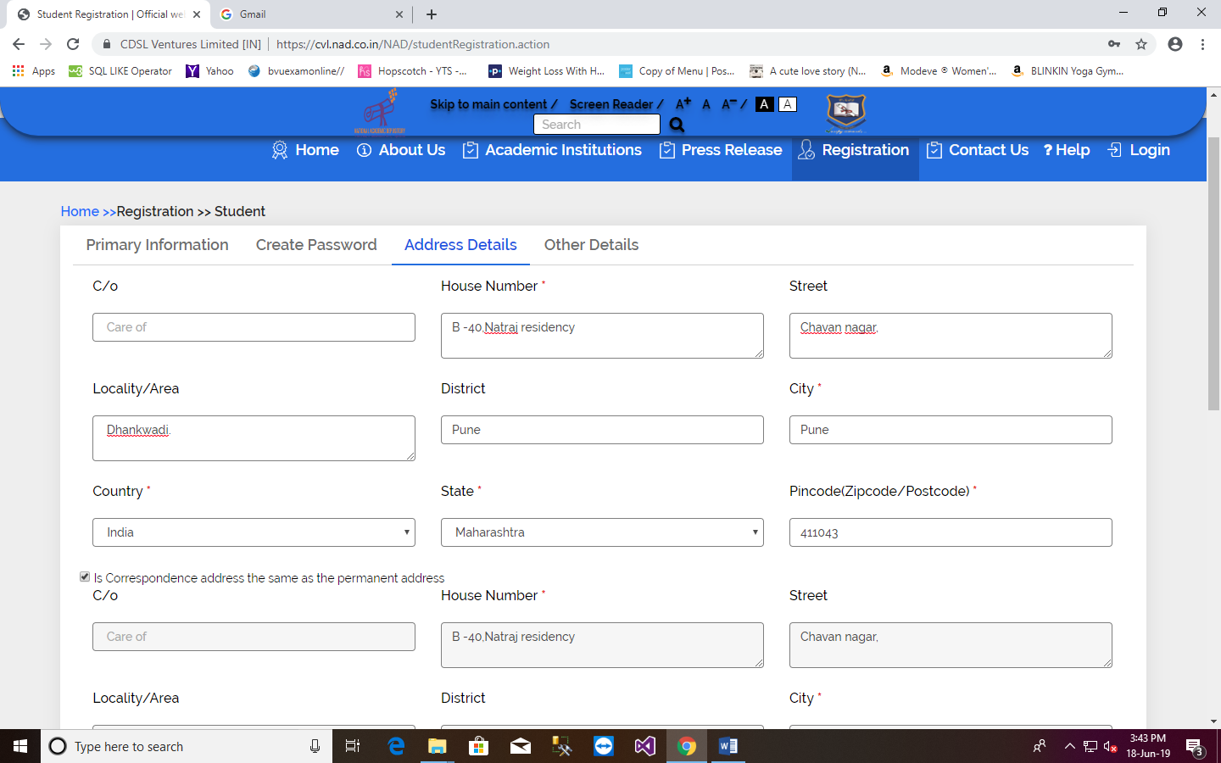
Address details
XXX
XXX
XXX
XXXXXX XXX
XXX
XXX

Slide 15
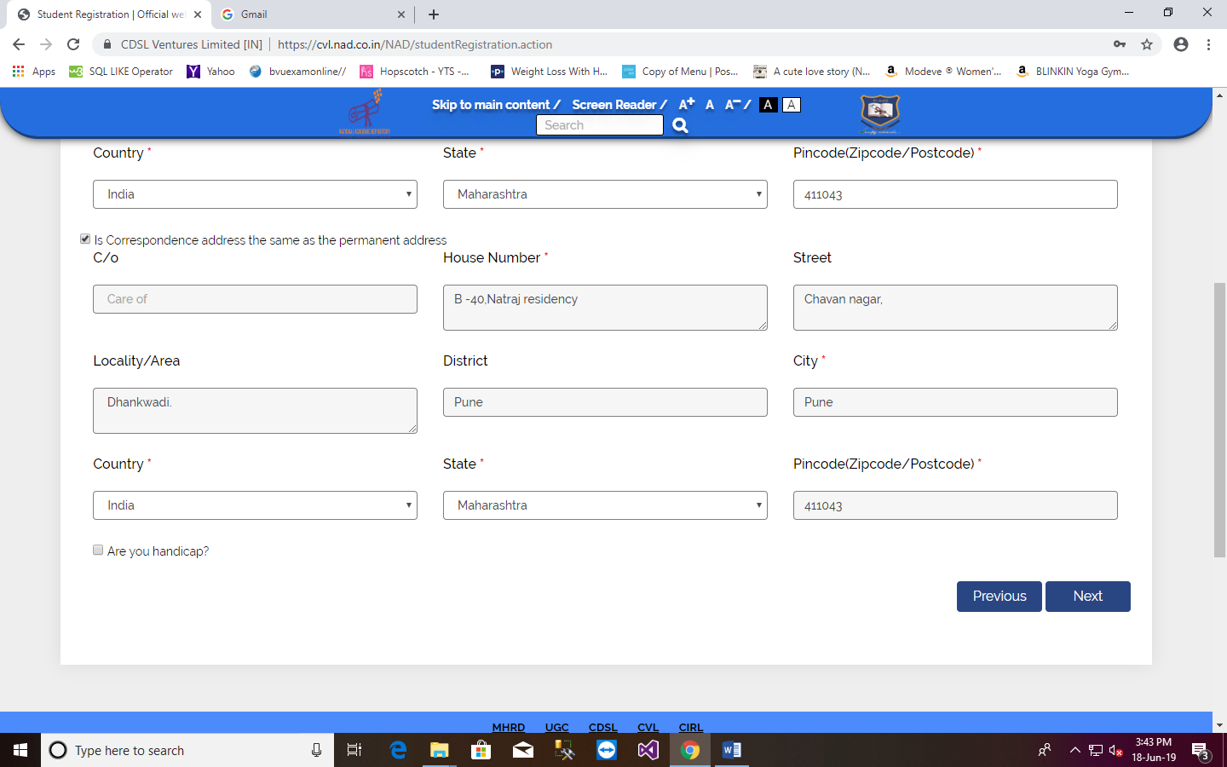
XXXXXX XXX
XXX
XXX
XXX
XXXXXX XXX

Slide 16
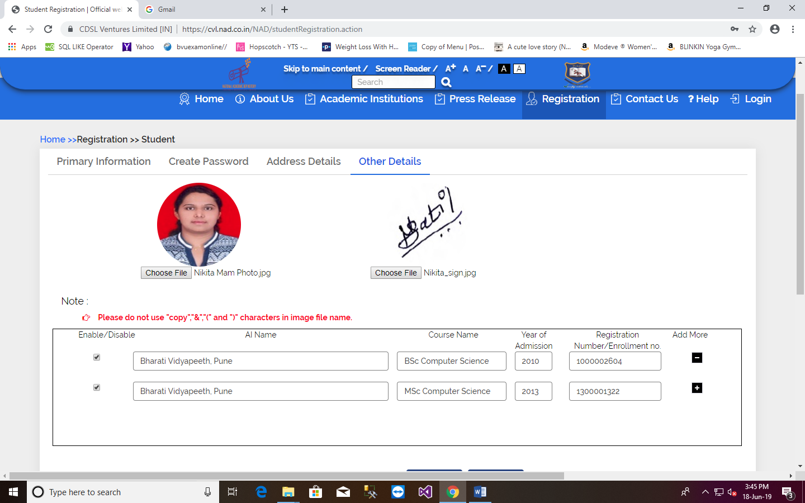
Other Details (Upload scan copy of Photograph and Signature)
Select AI Name as “Bharati Vidyapeeth, Pune”.

Slide 17
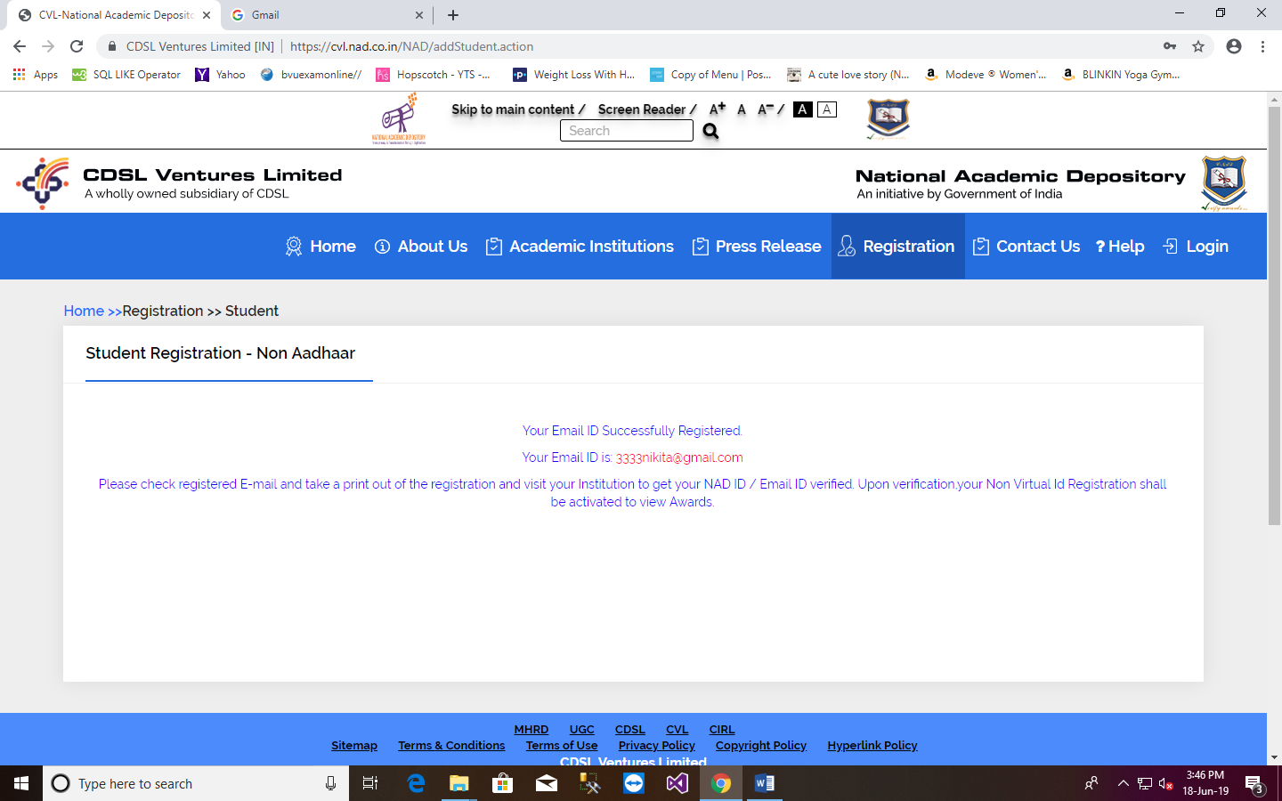
8.After registration student will receive an email for successful registration.
XXXXXXX@gmail.com

Slide 18
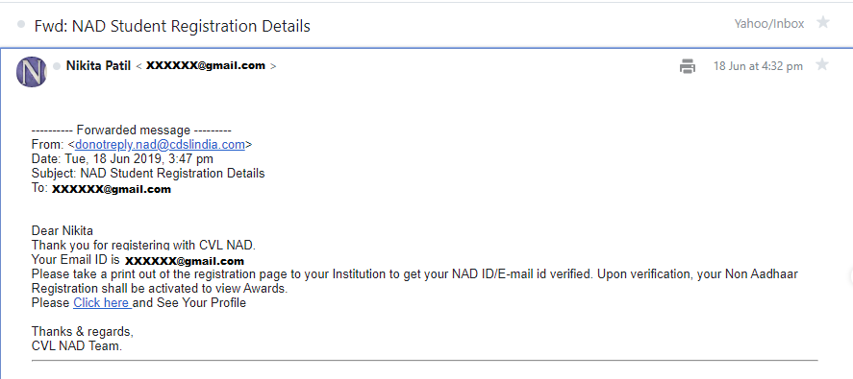
The email will appear as shown below,
Also take a print of your profile for your reference.

Slide 19
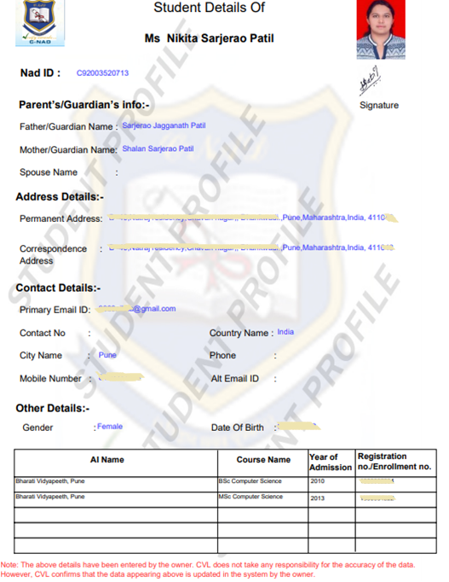

Slide 20
Now the student has to compulsory fill University’s online Form to get your NAD ID/ Email Id verified.
Visit http://bvuniversity.edu.in/ and go to Examinations tab and Click on “Click here for Verification for NAD ID” to Fill the University’s online Form.

Slide 21
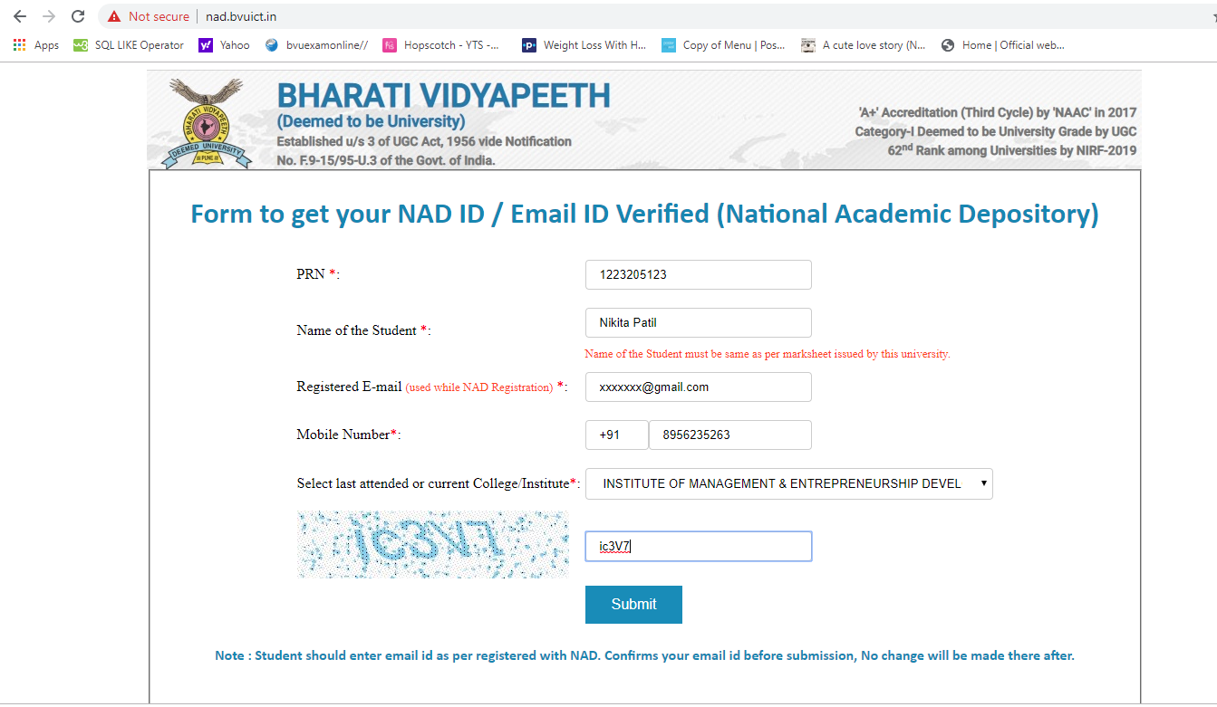
9.
Enter the PRN, Name as per marksheet, Mobile number, Email ID and college.
Student should enter the same mobile number and email Id as he/she has entered on NAD registration form.
Student should fill this form separately for each course passed / appeared from this University.

Slide 22
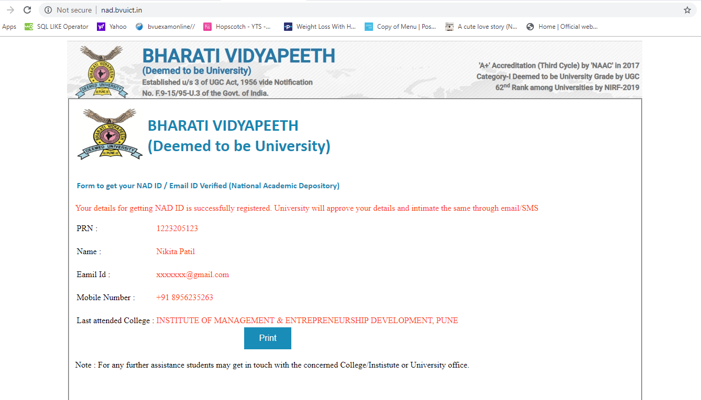
Confirmation Message which can be printed

Slide 23
………………..Registration Process ENDS here………………….

Slide 24
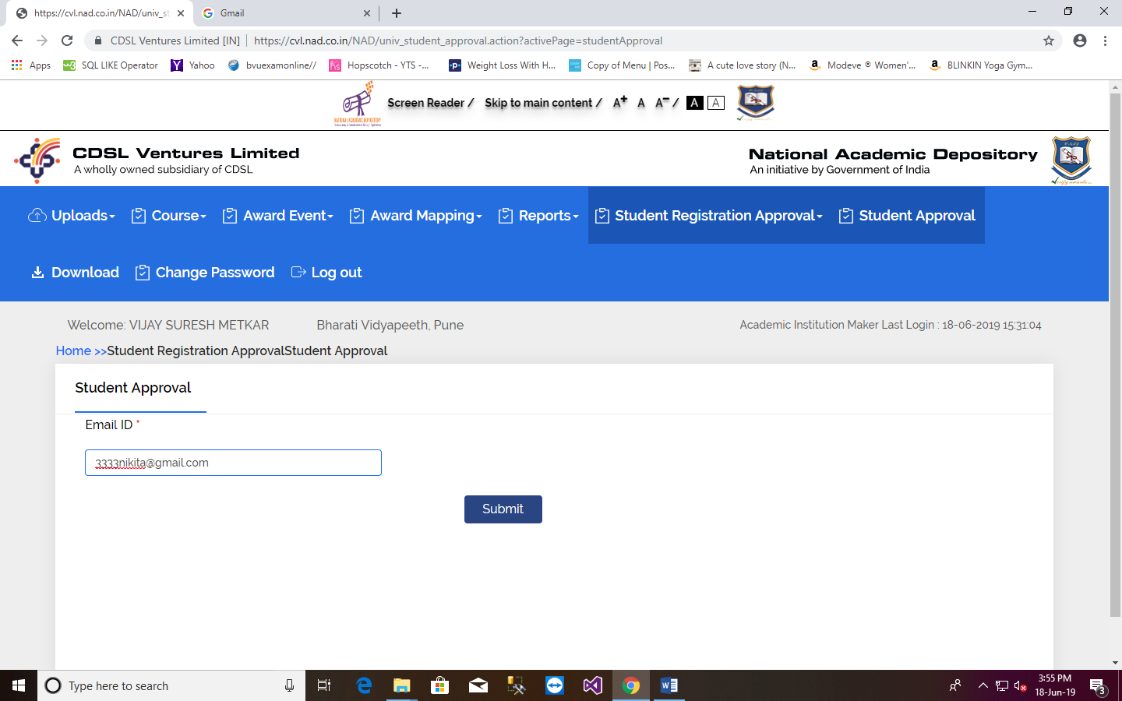
B. Verification of Student by UNIVERSITY
Enter Student’s email id below for approval/verification, this email id must be registered email id with NAD.

Slide 25
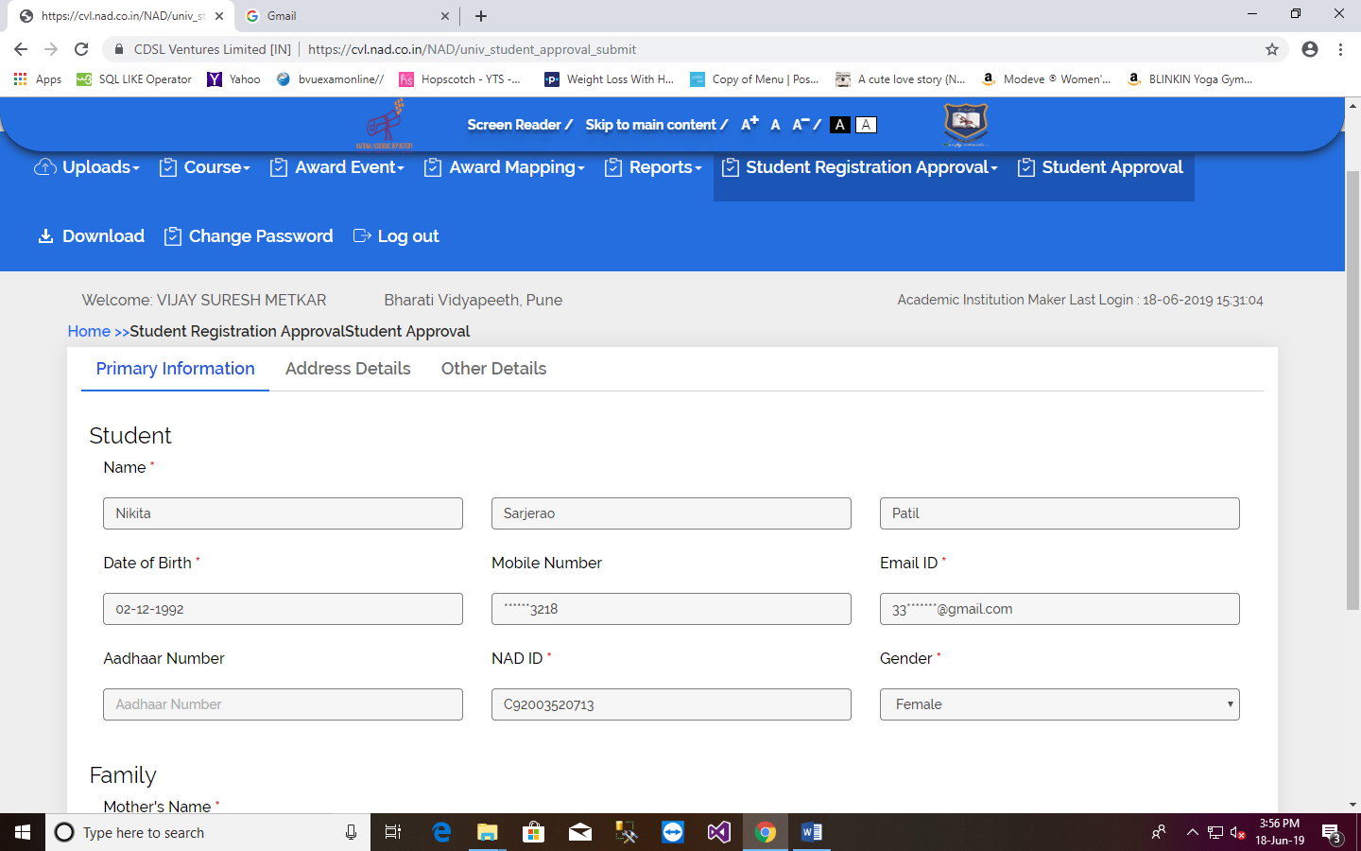
Check details of the student

Slide 26
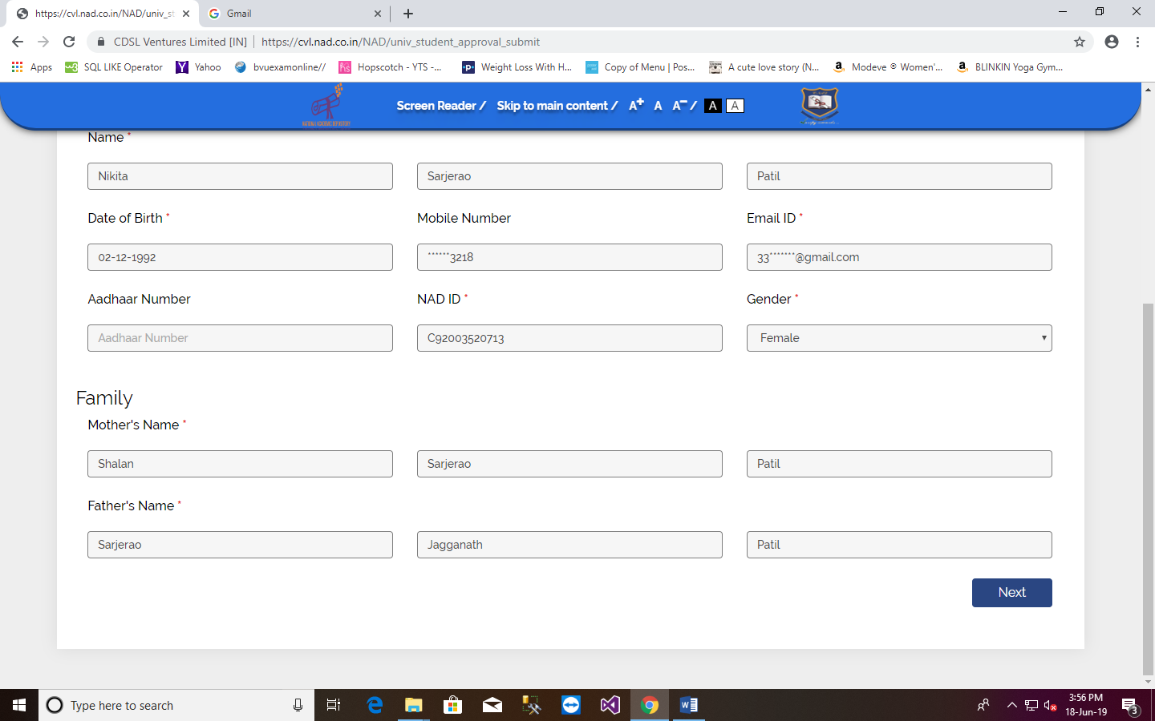
Check details of the student

Slide 27
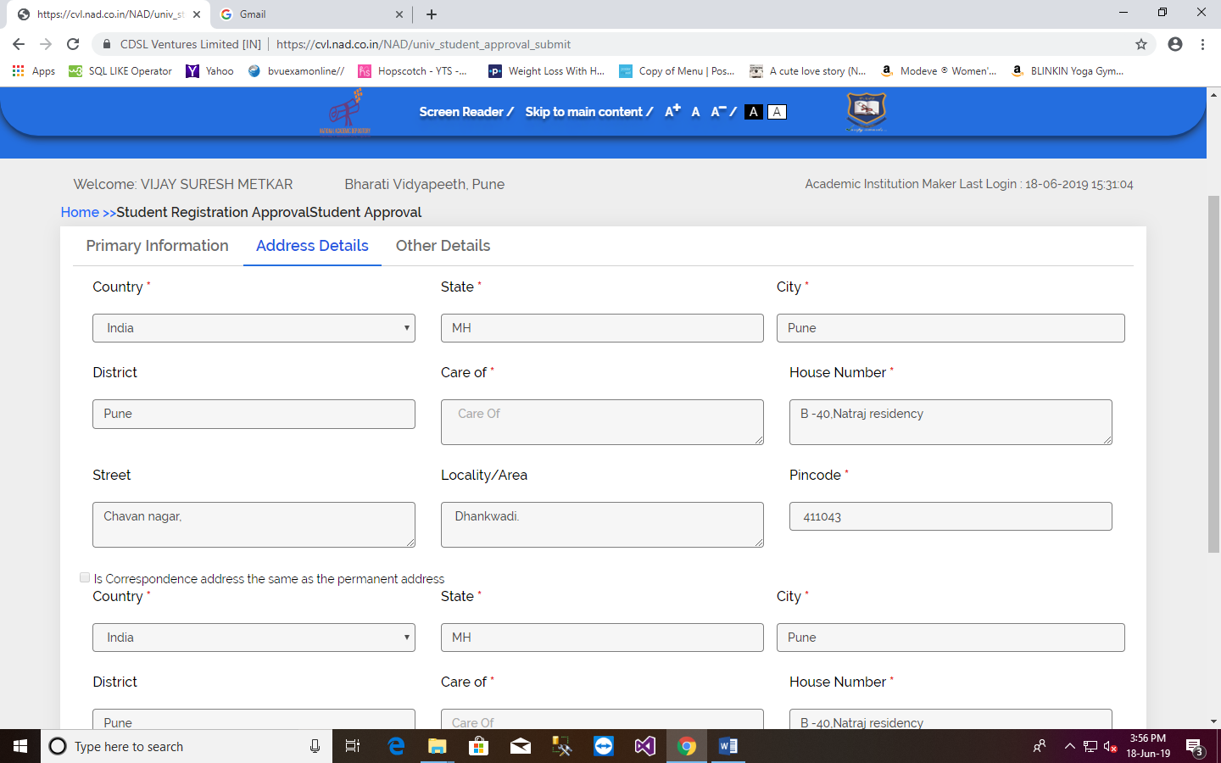
Check details of the student

Slide 28
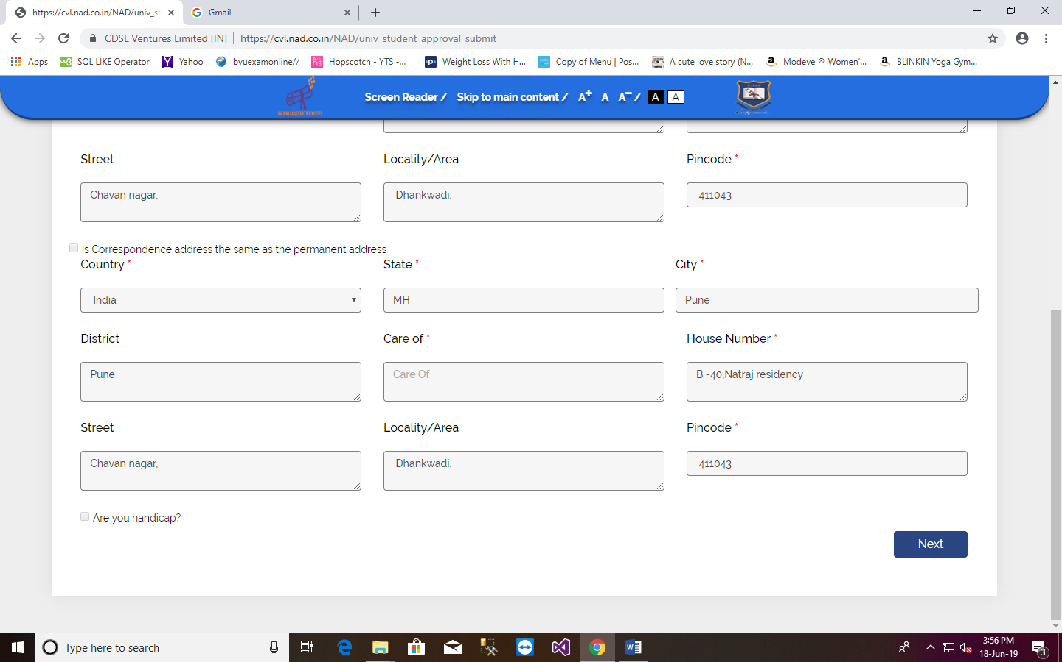
Check details of the student

Slide 29
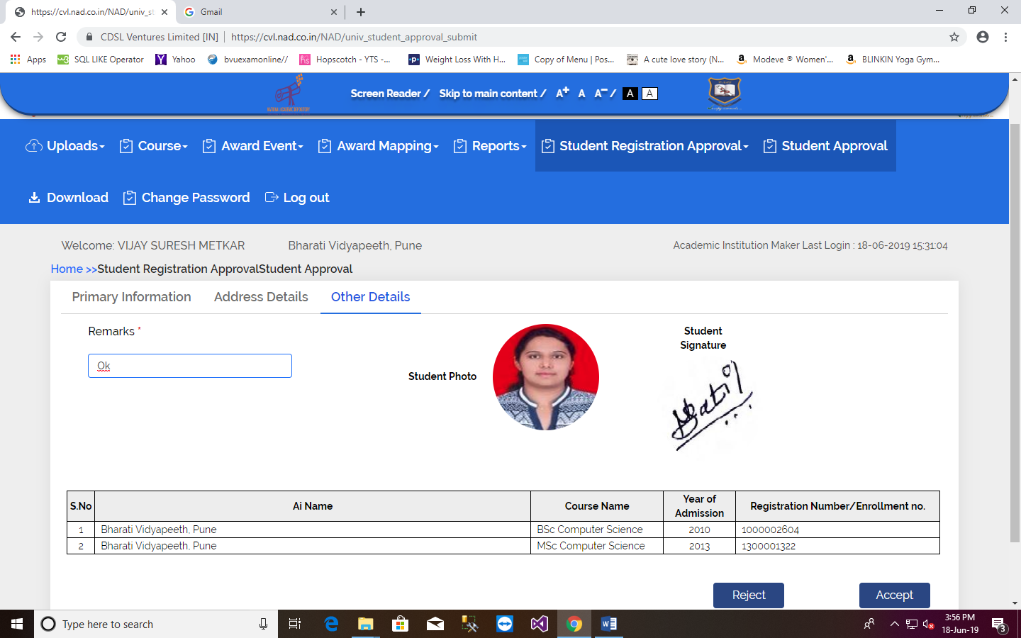
Check details of the student, Then given remark as OK and Click on Accept button.

Slide 30
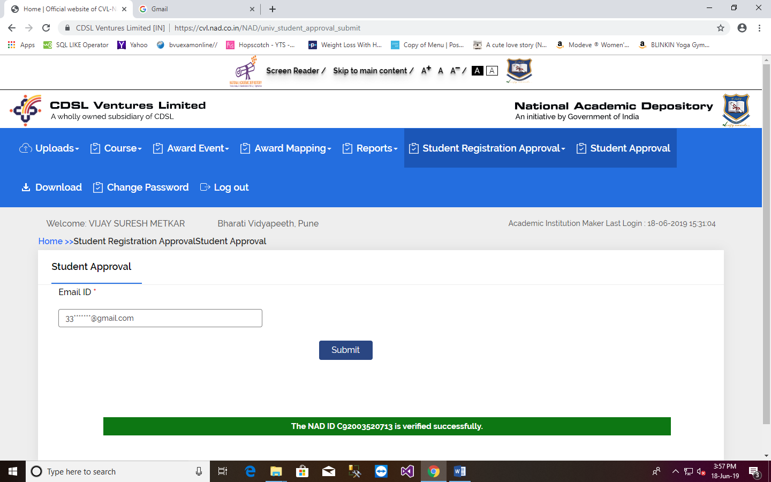
NAD Id is generated here, same will be sent on registered email id.

Slide 31
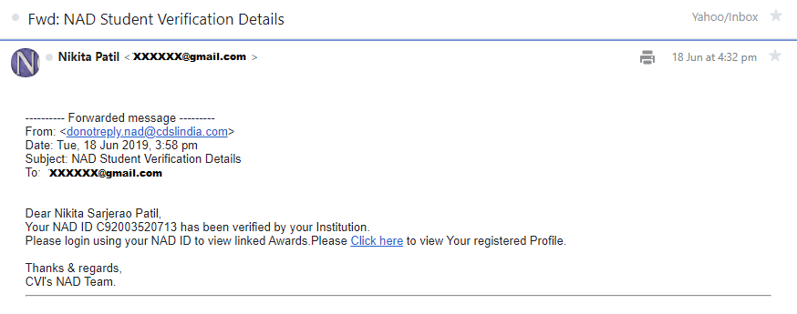
………………….University’s verification ENDS here……………………

Slide 32
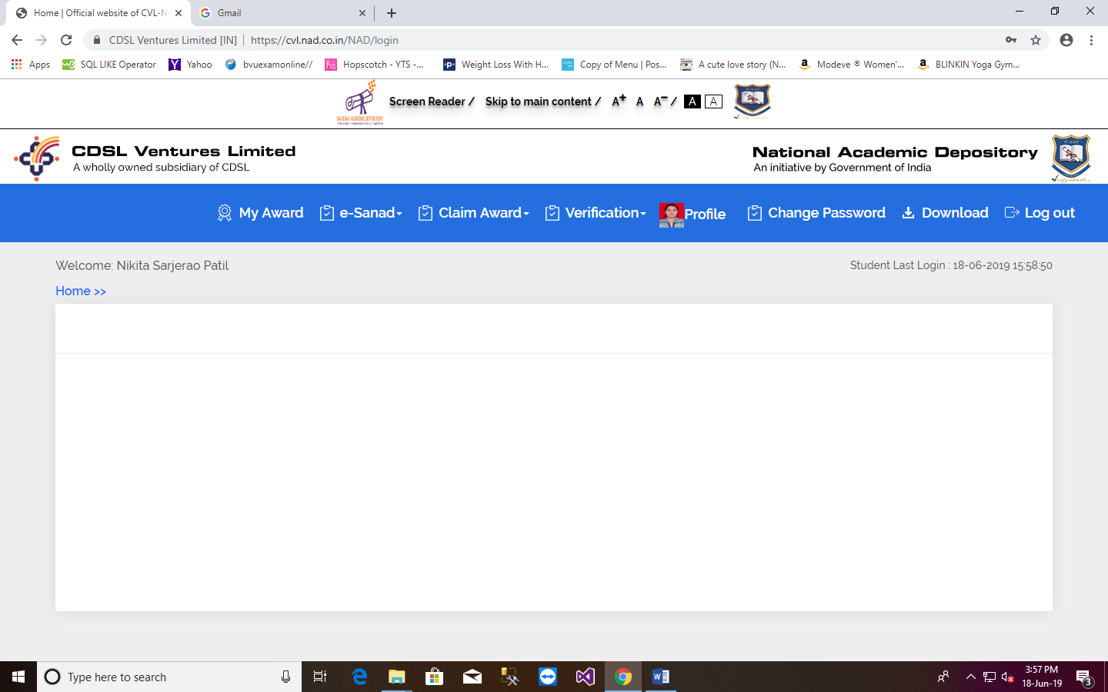
C. Award Mapping Process by Student
After Login, Student needs to click on Claim Awards.

Slide 33
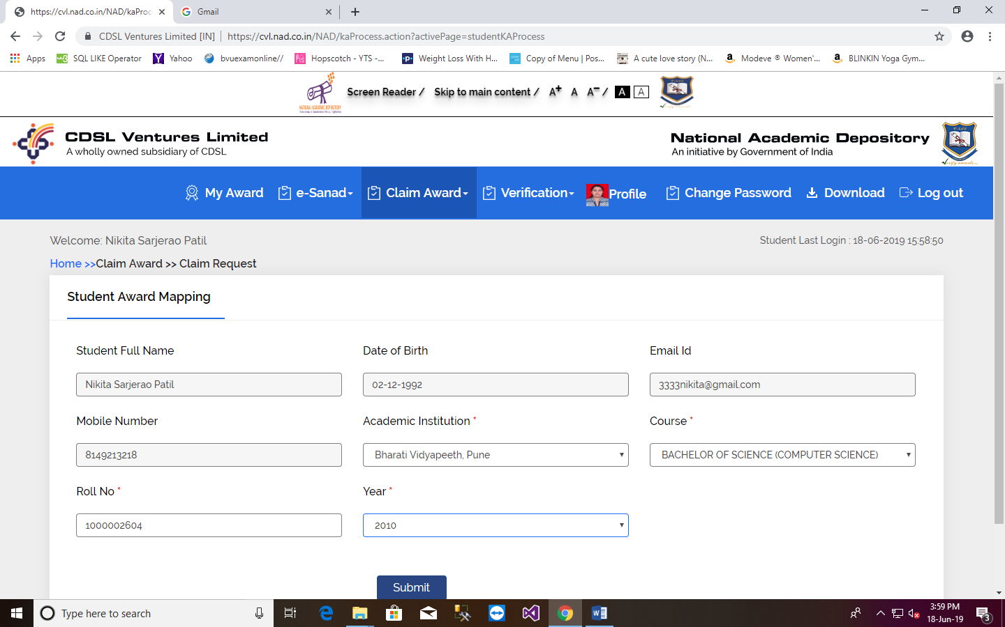
2. Student has to Fill the form, by giving University name, course name and enter PRN as Roll No and passing year.
XX-XX-XXXX XXX
XXXXXXXXXX@gmail.com
XXXXXXXXXX XXX

Slide 34
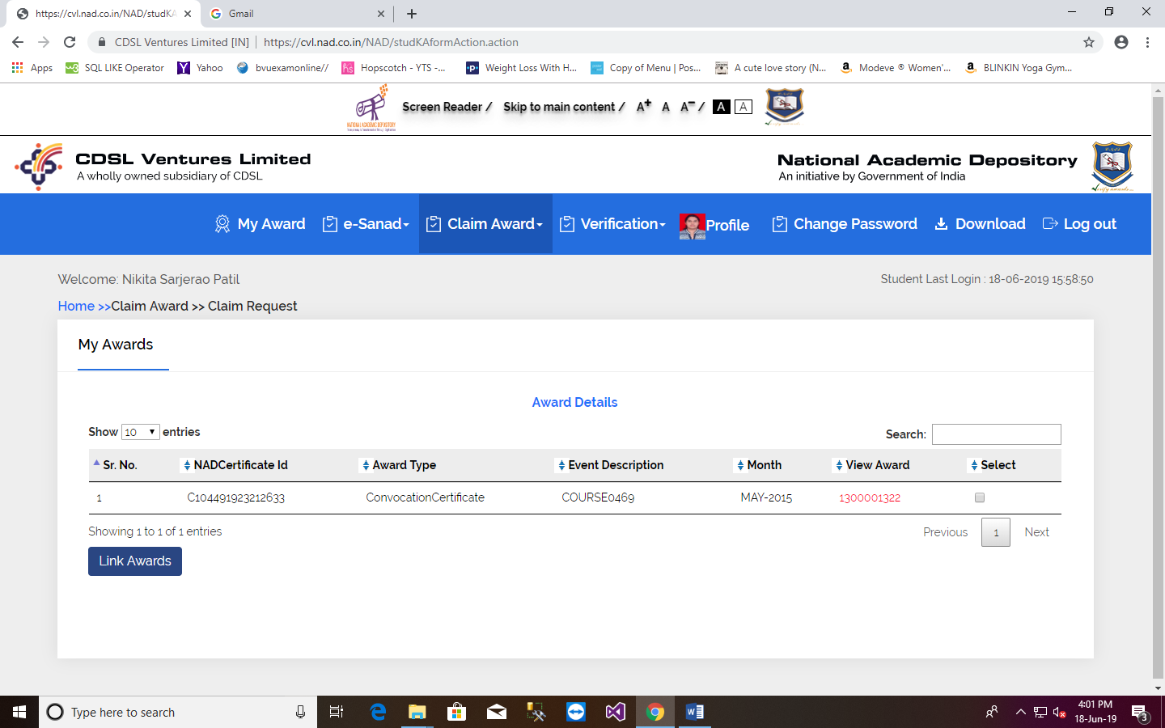
3. After this following screen appears,
4. Click on link which is highlighted above to see award. When student confirms the award(Degree certificate or Statement of marks/Grade card). Then student has to click on Link Awards button.

Slide 35
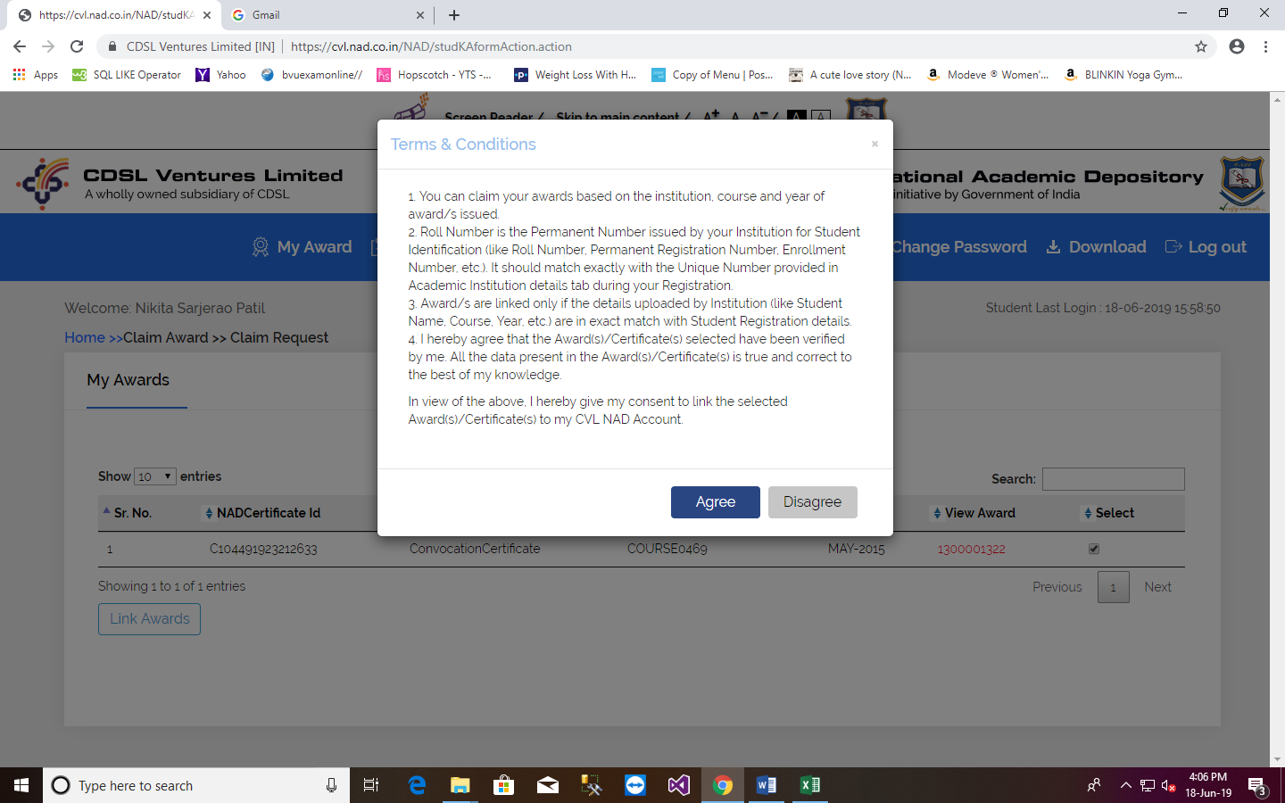
5. After clicking Link Award button, one pop up window will appear, Student needs to Agree it and OTP will be send to students email id.

Slide 36
6. The given OTP email will be displayed

Slide 37
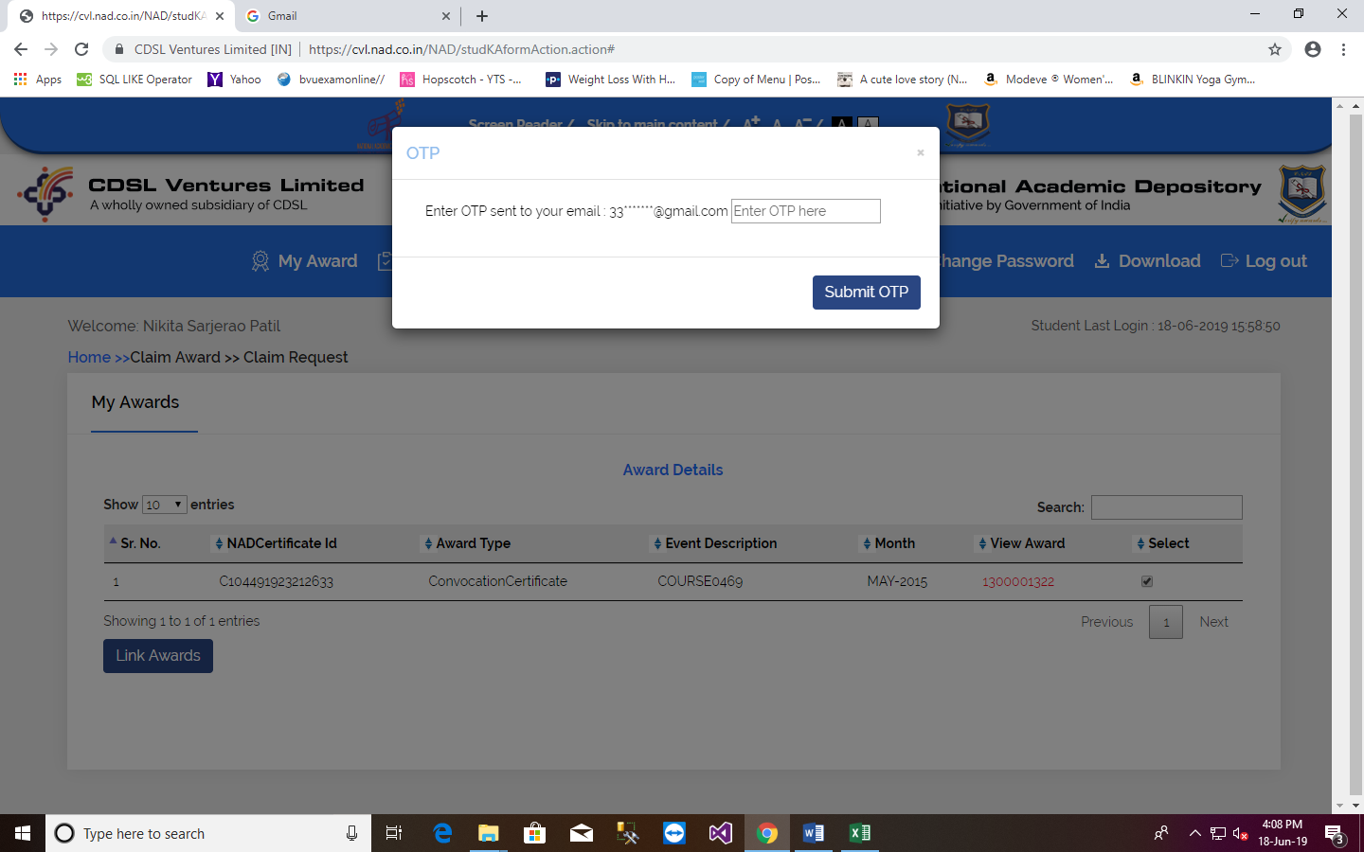
7. Student has to enter OTP here.

Slide 38
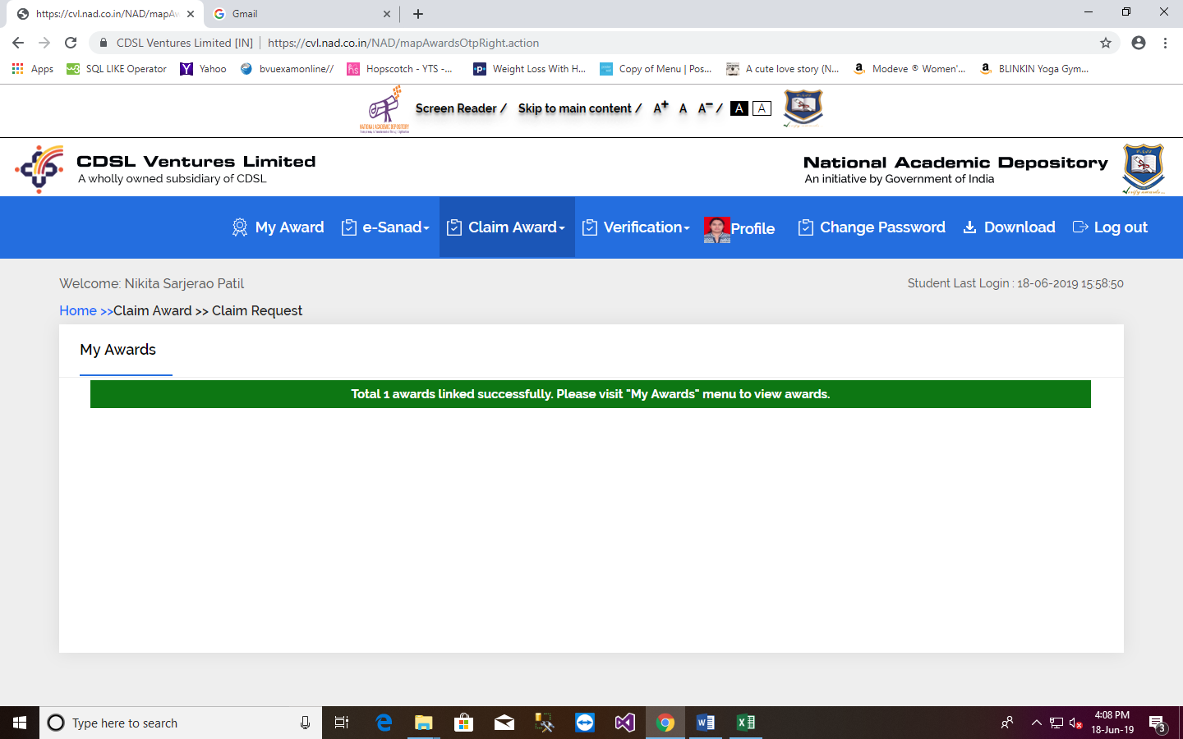
8. Now Award is linked successfully.

Slide 39
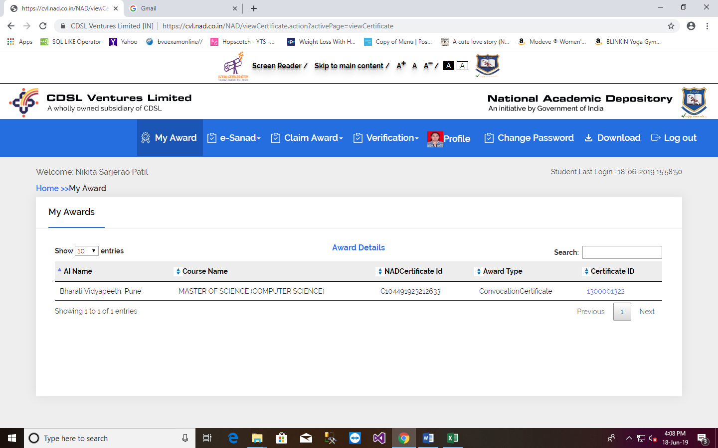
9. Student can view award by clicking on My Award menu. After that student has to click on PRN (which is highlighted below) to see award.

Slide 40
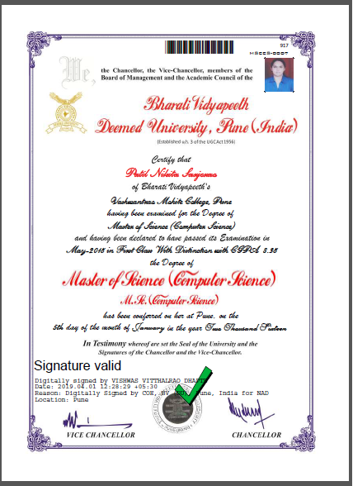
10. Award will get appear like this.
Bar Code
Student Photograph
AI Digital Signature
Hologram

Slide 41
Thank You

